Slide 1
Basics of Python (Part 2)
Prof. Yong Won SEO, Ph.D.
College of Business and Economics
Chung-Ang University

Slide 2
data types
Basics of Python

Slide 3
basic data types in python
Number
integer
float
String
List
Tuple
Dictionary
Set

Slide 4
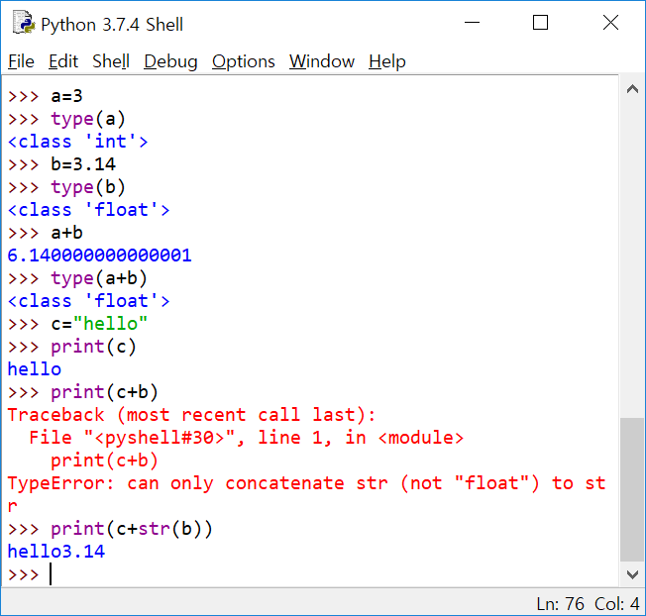

Slide 5
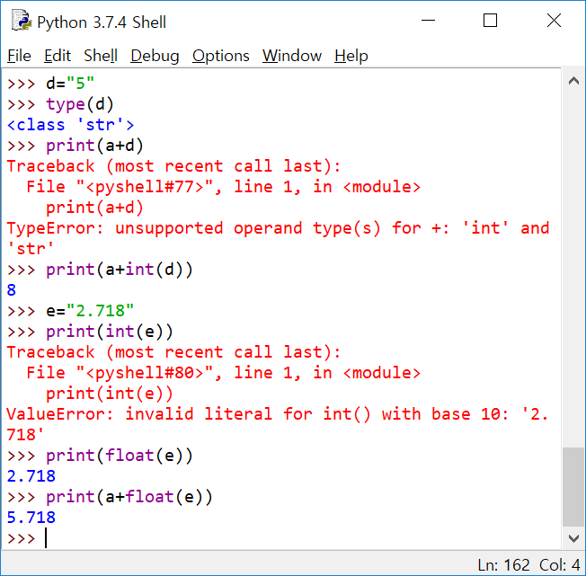

Slide 6
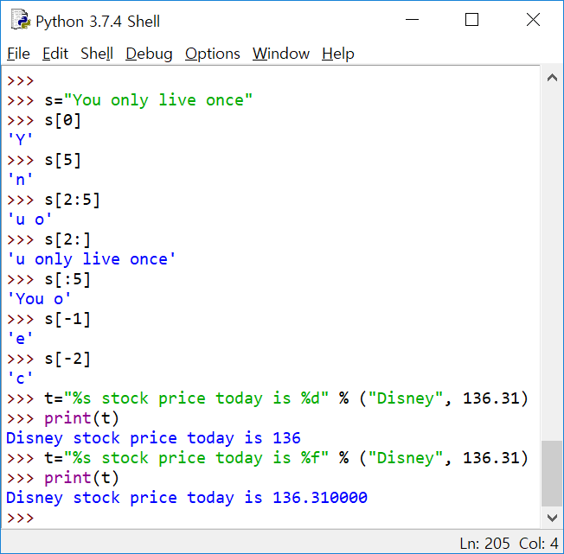
String

Slide 7
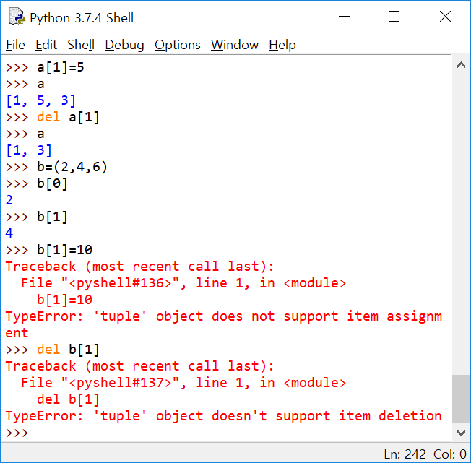
Tuple
Similar with list, but use ( ) instead of [ ], and unchangeable

Slide 8
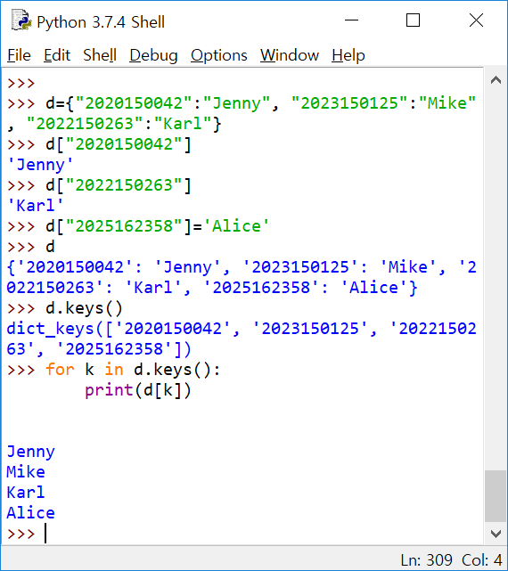
Dictionary
pairs of Key:Value
use { } to define

Slide 9
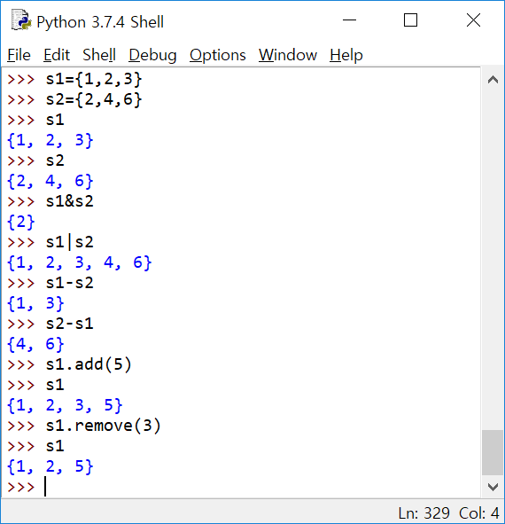
Set
Use { }
Unordered
Duplication not allowed

Slide 10
if statement
Basics of Python

Slide 11
Grammar of if statement
if condition :
statements to be executed
when the condition is met
else :
statements to be executed
when the condition is NOT met
statements outside if block

Slide 12
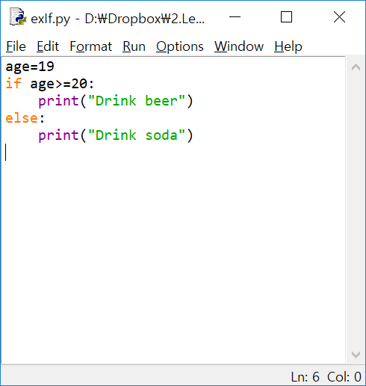

Slide 13
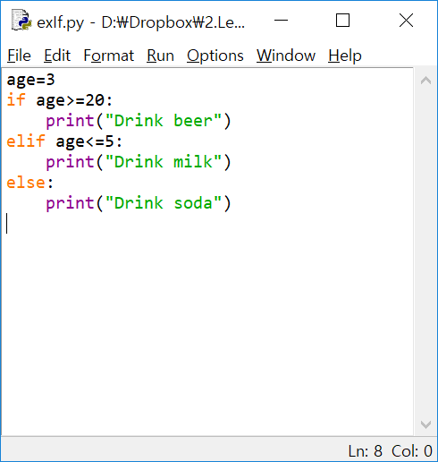

Slide 14
while loop
Basics of Python

Slide 15
Grammar of while statement
while condition :
statements to be executed repeatedly, should be indented
statements outside for loop

Slide 16
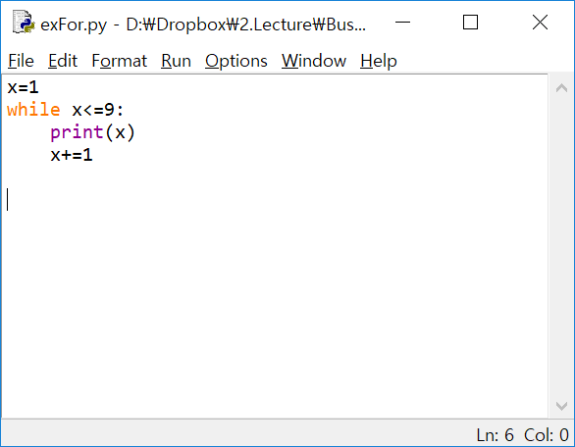

Slide 17
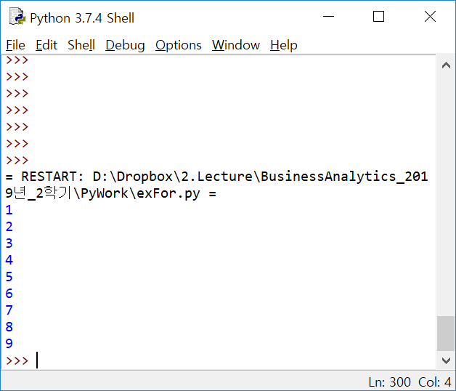

Slide 18
indentation
Aligned prevailing spaces to indicate a code block
A code block (body of a function, loop etc.) starts with indentation and ends with the first unindented line. The amount of indentation is up to you, but it must be consistent throughout that block.
Generally four whitespaces are used for indentation and is preferred over tabs.

Slide 19
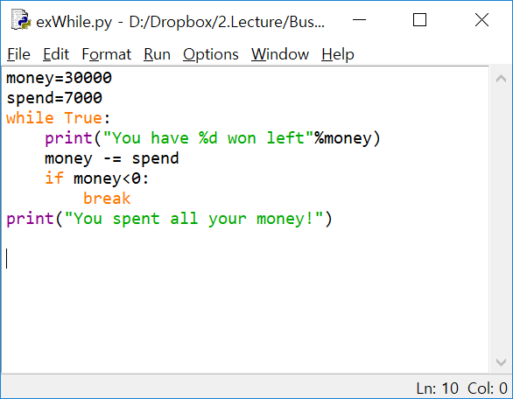

Slide 20
for loop
Basics of Python

Slide 21
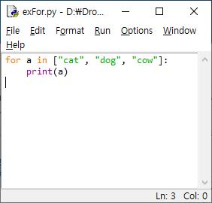

Slide 22
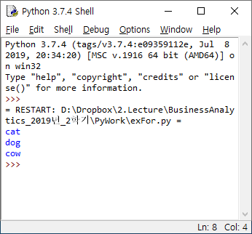

Slide 23
Grammar of for statement
for variable in list :
statements to be executed repeatedly, should be indented
statements outside for loop

Slide 24
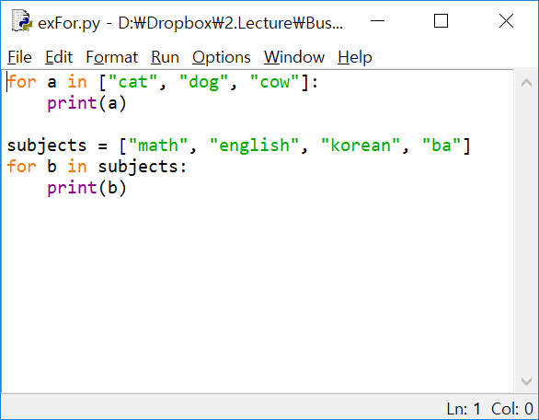

Slide 25
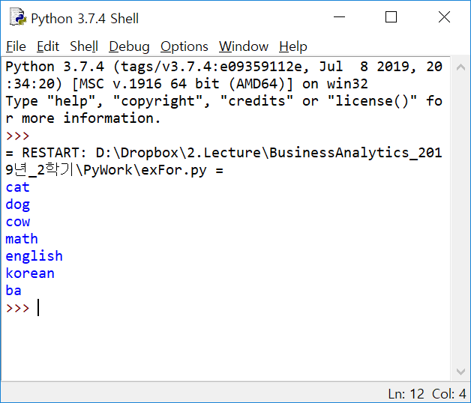

Slide 26
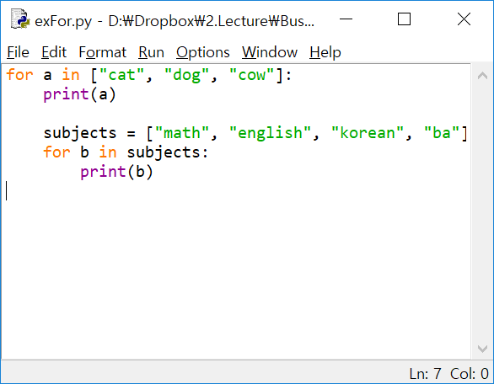

Slide 27
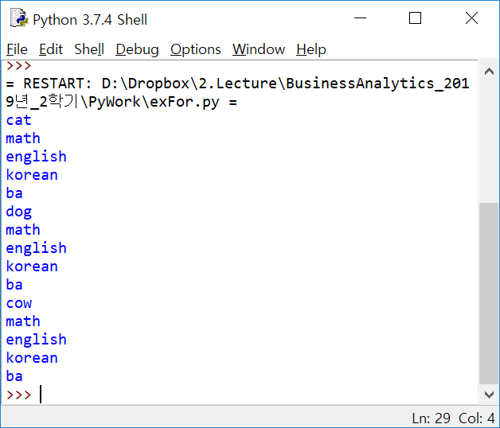

Slide 28
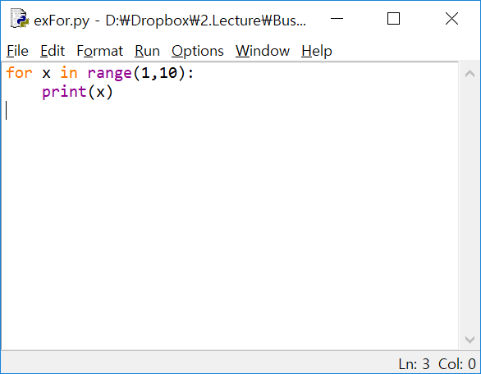

Slide 29
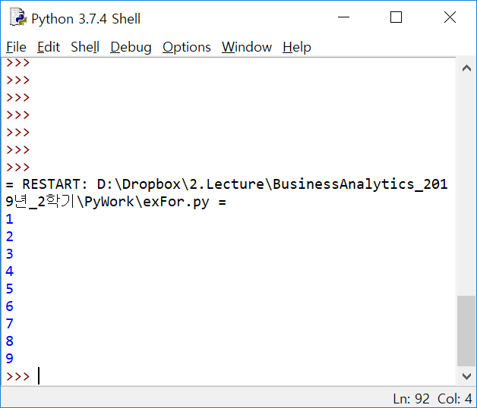

Slide 30
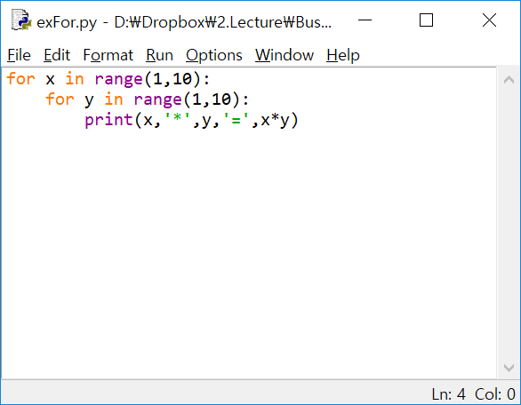
https://m.blog.naver.com/cinebsk/220070515431

Slide 31
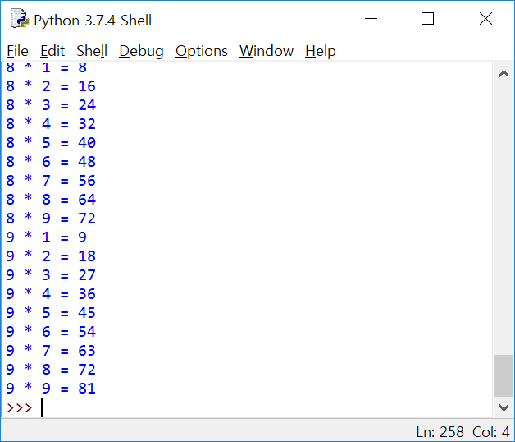

Slide 32
Function
Basics of Python

Slide 33
Input values …
Function
(do something with input values, return an output)
Output

Slide 34
Grammar of function
def function name(argument 1, argument 2, ..) :
processing code
return result

Slide 35
